Slide 1
Latent-Tuberculosis Effect on Host Pathways
Arthur VanValkenburg
8/28/19

Slide 2
Biomarkers help predict disease development
Latent infection- people don’t actually develop disease
10-15% of infected progress to disease
Only progressors need treatment
Several studies have searched for biomarkers
Predict 29 seems effective
We want to know a mechanism

Slide 3
Finding a Mechanism
Using SingleCellTK() for R
Looked at differentially regulated genes between latent and progressors
Used EnrichR database tool to find pathways

Slide 4
Differential analysis with shiny
Uploaded data
Transformed counts into “Counts per million” (CPM)
Also log₂(CPM) (log_cpm)
Performed differential analysis limma assay
Printed heatmap of top 500 and top 100 genes
Used results in EnrichR for several databases

Slide 5
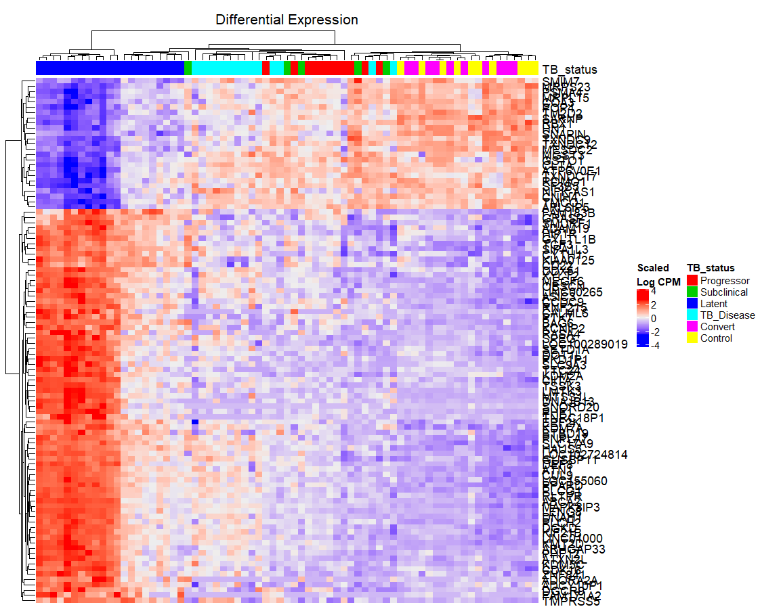
Top 100

Slide 6
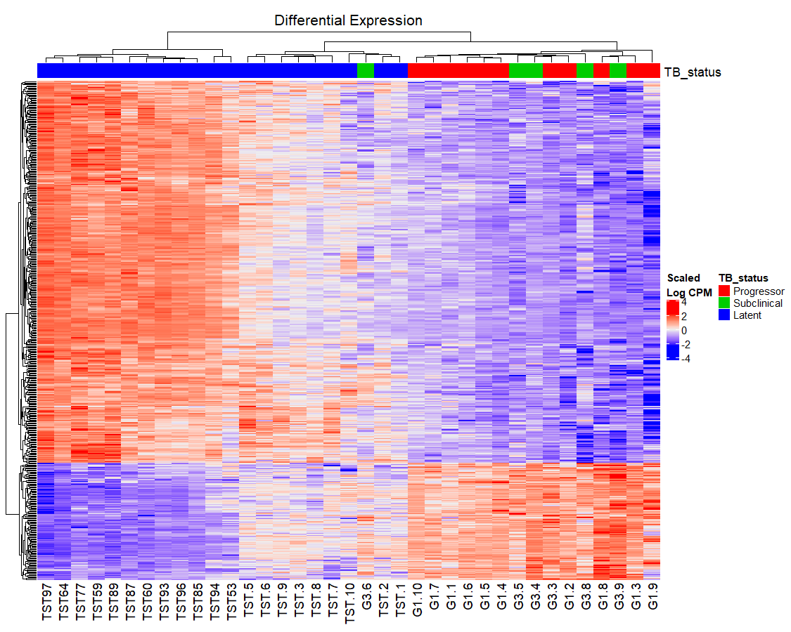
Top 500

Slide 7
Re-labeled Latent patients as latent_mid (as a middle group)
Filtered only latent_mid and progressors
Differential analysis yielded fewer top genes and only 136 pathways of interest using EnrichR

Slide 8
Yellow- inflammation (or possibly related HIV, WNT signaling)
Green- mitosis-related
Blue- hedgehog signaling
Red- metabolism
Blank- non-specific (i.e. Parkinson’s, non-alcoholic liver disease, transcription)

Slide 9
ENRICHR results
Inflammation/ infection
Cell cycle
SHH
WNT
Metabolism

Slide 10
Pathways of interest
Hh signaling in immune cells- not a lot of info
Saw both up and downregulation here (normal, self-regulating)
Leads to strengthening of BBB
Dectin-1- in 2010 dectin-deficient mice cleared mycobacteria just fine

Slide 11
Dectin-1 may be important for TB clearance
May work with TLR2, recognizes β-glycan, although TB doesn’t have it, Dectin-1 has been suggested to be important in vitro for recognizing TB
Can induce CD4 T cells and Th17, independent of TLR2
Inhibition helps with autoimmune arthritis in mice
Affects all branches of immune system
β-glycan treatment helps clear TB in vitro
DC-Sign interferes with Dectin-1 activity, implicated in TB persistence in alveolar M2(IL-4) macrophages

Slide 12
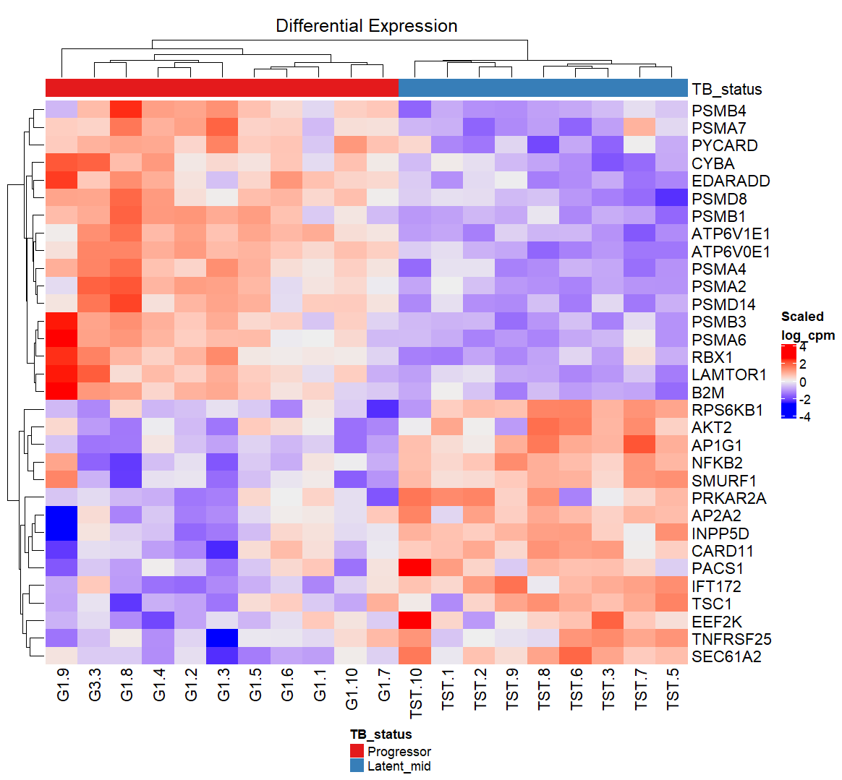
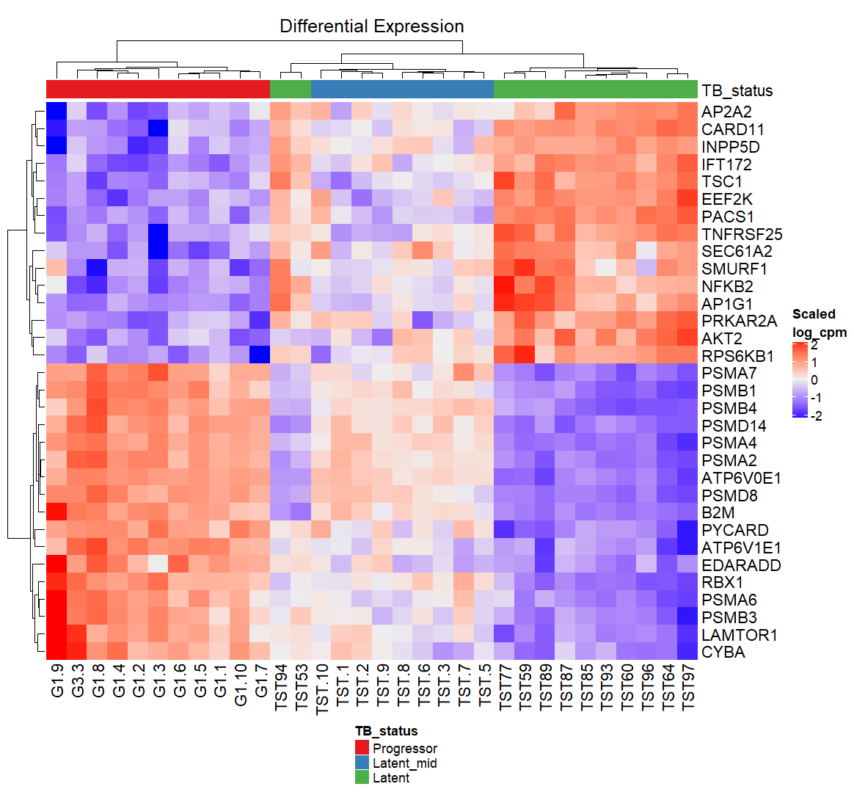
Dectin-1/CLR signaling genes are differentially expressed between latents and progressors

Slide 13
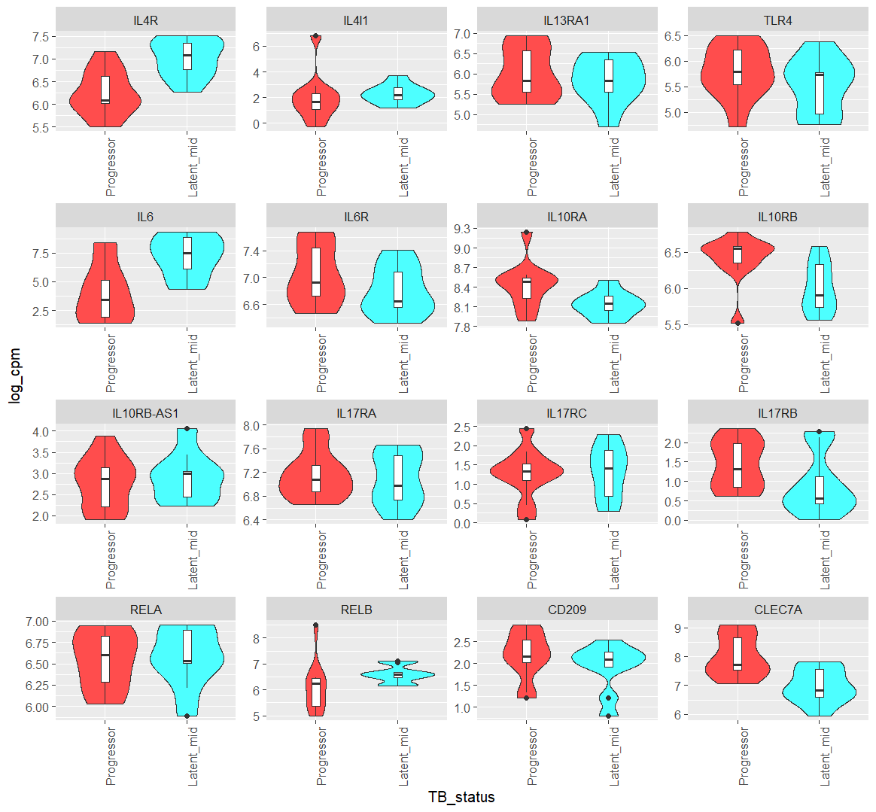
Latents decrease Dectin-1 expression
Receptors and genes involved in inflammation, some influenced by DC-Sign (CD209) or Dectin-1 (CLEC7A)
After clearance,

Slide 14
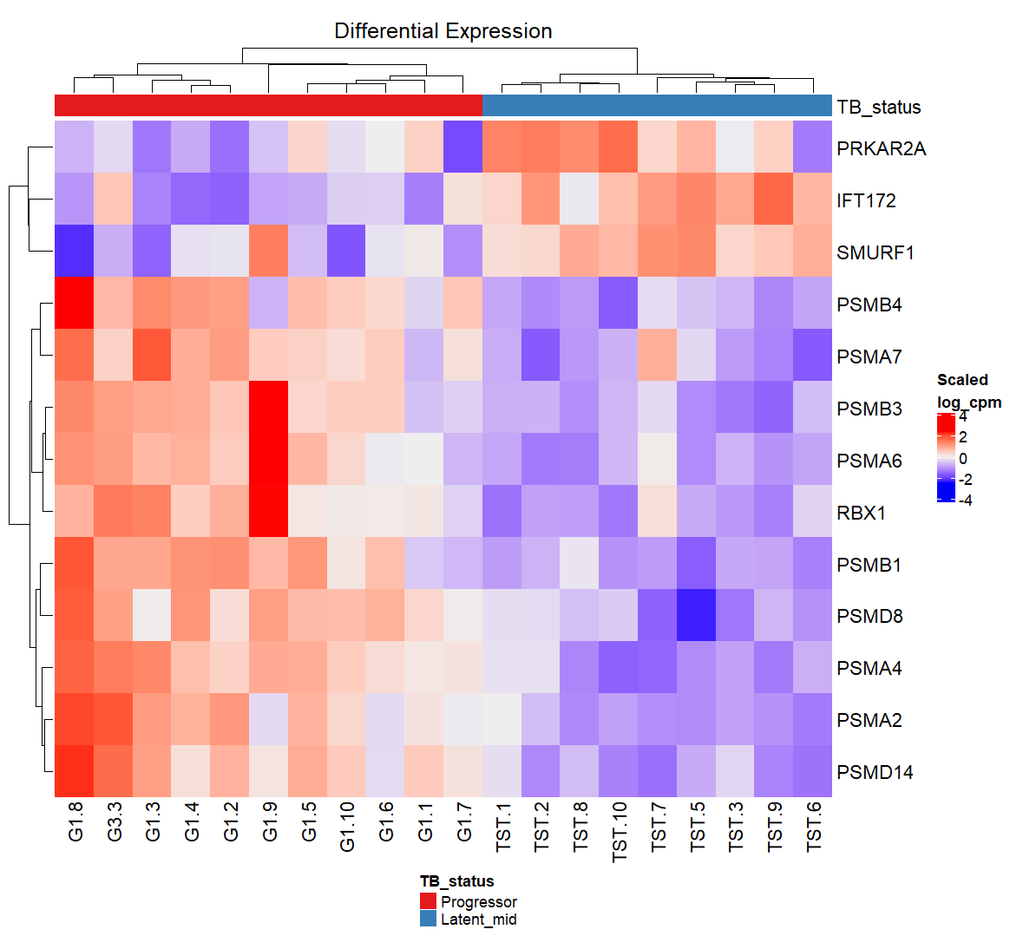
Hedgehog signaling
Some are involved in upregulation and some suppression
Mostly “off” in latent, “on” in progressors

Slide 15
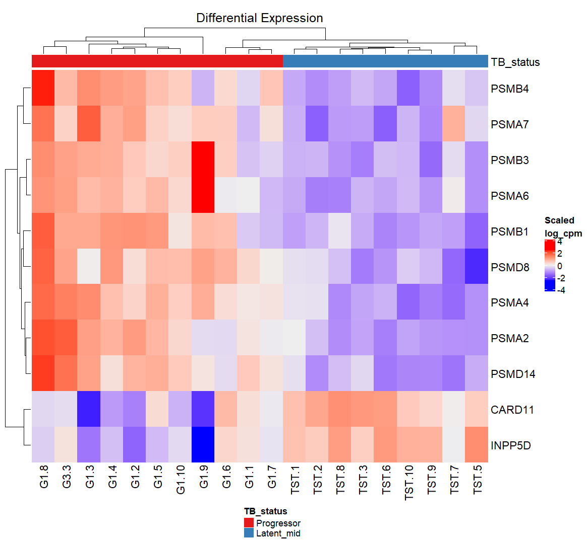
TCR signaling
CARD11- vital for T cell activity, activates NFKB, BCL10 phosphorylation
INPP5D- negative regulator of myeloid proliferation

Slide 16
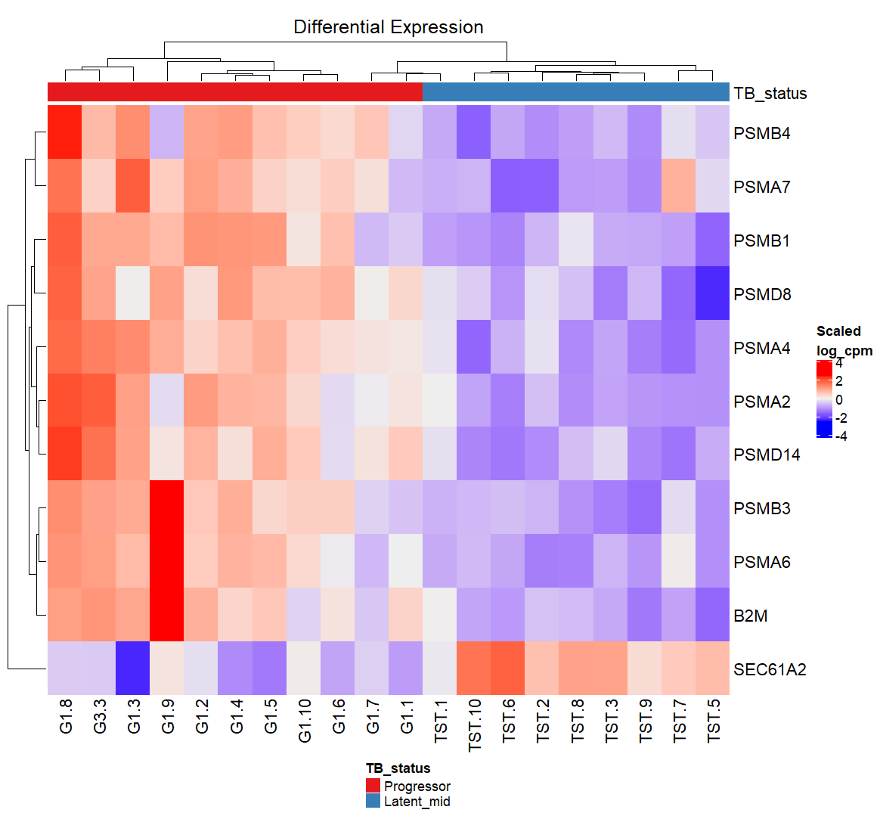
Phagocytosis
SEC61A2- inserts proteins into membranes of ER for secretion/membrane bound

